Slide 1
Welcome to Databrics

Slide 2
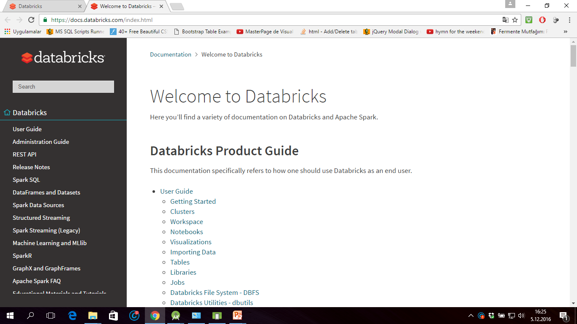
Documentation

Slide 3
Databricks Terminology
Workspaces
Workspaces allow you to organize all the work that you are doing on Databricks. Like a folder structure in your computer, it allows you to save notebooks and libraries and share them with other users. Workspaces are not connected to data and should not be used to store data. They're simply for you to store the notebooks and libraries that you use to operate on and manipulate your data with.

Slide 4
Notebooks
Notebooks are a set of any number of cells that allow you to execute commands. Cells hold code in any of the following languages: Scala, Python, R, SQL, or Markdown. Notebooks have a default language, but each cell can have a language override to another language. This is done by including %[language name] at the top of the cell. For instance %python. We'll see this feature shortly.
Notebooks need to be connected to a cluster in order to be able to execute commands however they are not permanently tied to a cluster. This allows notebooks to be shared via the web or downloaded onto your local machine.
Here is a demonstration video of Notebooks.(https://www.youtube.com/embed/MXI0F8zfKGI)

Slide 5
Libraries
Libraries are packages or modules that provide additional functionality that you need to solve your business problems. These may be custom written Scala or Java jars; python eggs or custom written packages. You can write and upload these manually or you may install them directly via package management utilities like pypi or maven

Slide 6
Tables
Tables are structured data that you and your team will use for analysis. Tables can exist in several places. Tables can be stored on Amazon S3, they can be stored on the cluster that you're currently using, or they can be cached in memory. For more about tables see the documentation.

Slide 7
Clusters
Clusters are groups of computers that you treat as a single computer. In Databricks, this means that you can effectively treat 20 computers as you might treat one computer. Clusters allow you to execute code from notebooks or libraries on set of data. That data may be raw data located on S3 or structured data that you uploaded as a table to the cluster you are working on.
It is important to note that clusters have access controls to control who has access to each cluster.
Here is a demonstration video of Clusters. (https://www.youtube.com/embed/2-imke2vDs8)

Slide 8
Jobs
Jobs are the tool by which you can schedule execution to occur either on an already existing cluster or a cluster of its own. These can be notebooks as well as jars or python scripts. They can be created either manually or via the REST API.
Here is a demonstration video of Jobs. (https://www.youtube.com/embed/srI9yNOAbU0)

Slide 9
Apps
Apps are third party integrations with the Databricks platform. These include applications like Tableau. (www.tableau.com/)

Slide 10
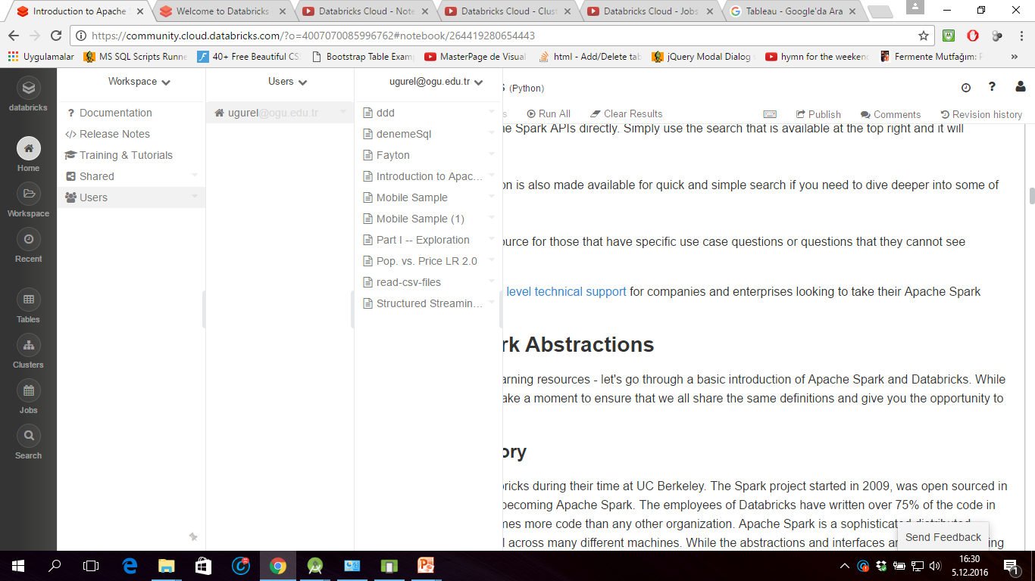

Slide 11
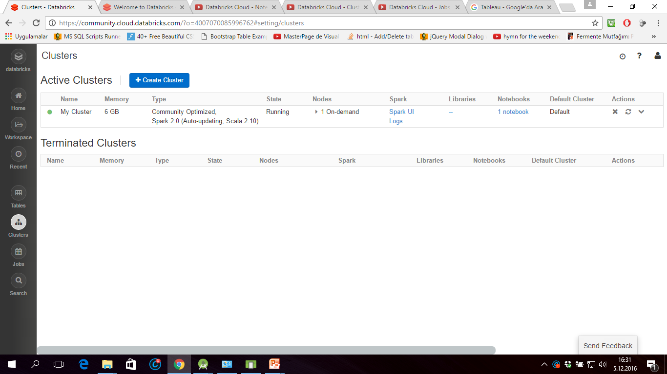
Cluster

Slide 12
Commands
displayHTML('https://youtube.com/embed/_cwcr1EEYns')

Slide 13
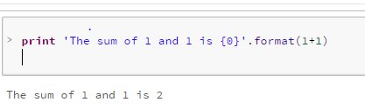
Print Something

Slide 14
data = sc.parallelize([('a', 1), ('b', 5), ('c', 3)])
df = sqlContext.createDataFrame(data)
display(df)

Slide 15
Use Help
help(sc)

Slide 16
Working with your first RDD
we first create a base Resilient Distributed Dataset (RDD). We can then apply one or more transformations to that base RDD. An RDD is immutable, so once it is created, it cannot be changed. As a result, each transformation creates a new RDD.

Slide 17
We will perform several exercises to obtain a better understanding of RDDs:
Create a Python collection of 10,000 integers
Create a Spark base RDD from that collection
Subtract one from each value using map
Perform action collect to view results
Perform action count to view counts
Apply transformation filter and view results with collect
Learn about lambda functions

Slide 18
Create a Python collection of 10,000 integers
data = xrange(1, 10001)
print data[0] or data[0]
Get count len(data)

Slide 19
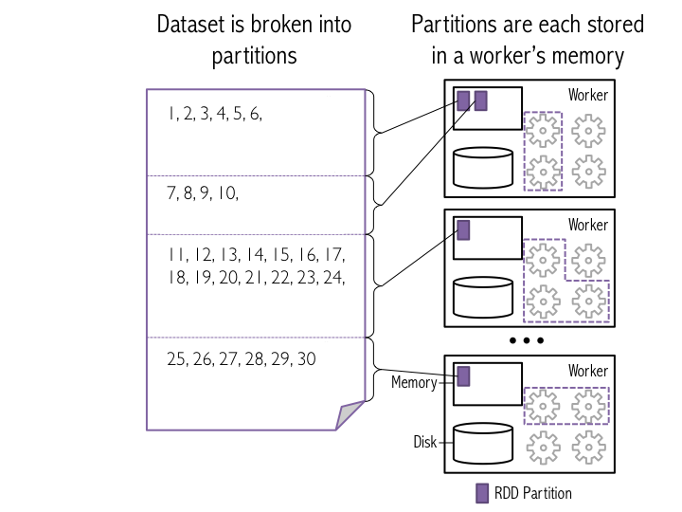
Distributed data and using a collection to create an RDD
One of the defining features of Spark, compared to other data analytics frameworks (e.g., Hadoop), is that it stores data in memory rather than on disk. This allows Spark applications to run much more quickly, because they are not slowed down by needing to read data from disk. The figure below illustrates how Spark breaks a list of data entries into partitions that are

Slide 20
Create RDD
To create the RDD, we use sc.parallelize(), which tells Spark to create a new set of input data based on data that is passed in. In this example, we will provide an xrange. The second argument to the sc.parallelize() method tells Spark how many partitions to break the data into when it stores the data in memory

Slide 21
# Parallelize data using 8 partitions
# This operation is a transformation of data into an RDD
# Spark uses lazy evaluation, so no Spark jobs are run at this point
xrangeRDD = sc.parallelize(data, 8)
help(sc.parallelize)

Slide 22
print 'type of xrangeRDD: {0}'.format(type(xrangeRDD))
print 'type of data: {0}'.format(type(data))
# Let's see how many partitions the RDD will be split into by using the getNumPartitions()
xrangeRDD.getNumPartitions()

Slide 23
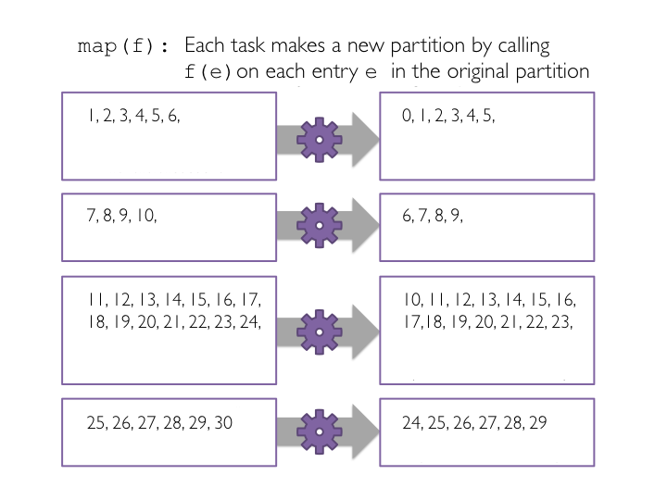
Subtract one from each value using map

Slide 24
How ?
def sub(value):
return (value - 1)
# Transform xrangeRDD through map transformation using sub function
# Because map is a transformation and Spark uses lazy evaluation, no jobs, stages,
# or tasks will be launched when we run this code.
subRDD = xrangeRDD.map(sub)

Slide 25
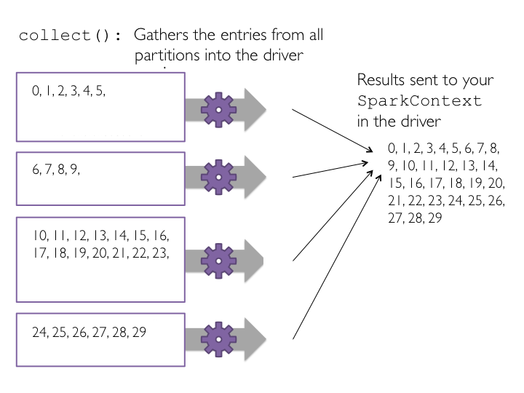
Perform action collect to view results
print subRDD.collect()

Slide 26
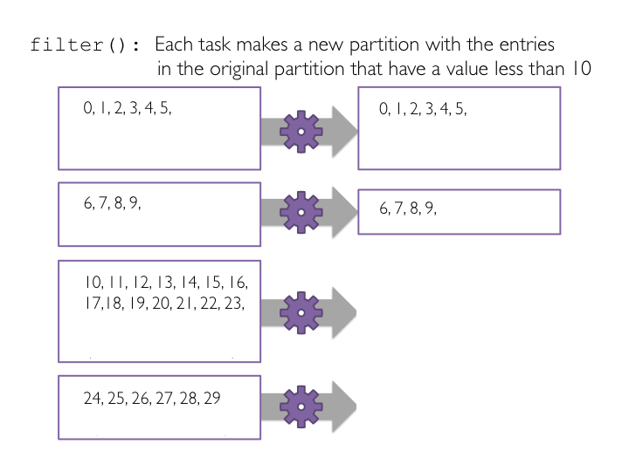
Apply transformation filter and view results with collect

Slide 27
# Define a function to filter a single value
def ten(value):
if (value < 10):
return True
else:
return False
# The ten function could also be written concisely as: def ten(value): return value < 10
# Pass the function ten to the filter transformation
# Filter is a transformation so no tasks are run
filteredRDD = subRDD.filter(ten)
# View the results using collect()
# Collect is an action and triggers the filter transformation to run
print filteredRDD.collect()

Slide 28
# Let's get the first element
print filteredRDD.first()
# The first 4
print filteredRDD.take(4)
# Retrieve the three smallest elements
print filteredRDD.takeOrdered(3)
# Retrieve the five largest elements
print filteredRDD.top(5)

Slide 29
Make words plural
# Let's create a new base RDD to work from
wordsList = ['cat', 'elephant', 'rat', 'rat', 'cat']
wordsRDD = sc.parallelize(wordsList, 4)
# Use map
singularAndPluralWordsRDDMap = wordsRDD.map(lambda x: (x, x + 's'))
# View the results
print singularAndPluralWordsRDDMap.collect()
# View the number of elements in the RDD
print singularAndPluralWordsRDDMap.count()

Slide 30
his analysis will explore the popularity of baby names since 2007 using a public dataset found on data.gov, and provided by the state of New York.

Slide 31
Data.gov
DESCRIBE ny_baby_names
select distinct county, sum(cnt) as totals from ny_baby_names group by county order by totals desc LIMIT 20
select n.year, n.baby_name, sum(n.cnt) totals from ny_baby_names n join (select baby_name from ny_baby_names group by year, baby_name having sum(cnt) > 1330) top_names on n.baby_name = top_names.baby_namegroup by n.year, n.baby_name order by n.baby_name, n.year
select n.year, n.sex, sum(n.cnt) totals from ny_baby_names n group by n.year, n.sex

Slide 32
Wordcount (Scala)
https://docs.cloud.databricks.com/docs/spark/1.6/index.html#examples/Dataset%20Wordcount.html
dbutils.fs.put("/home/spark/1.6/lines","""Hello hello world Hello how are you world""", true)

Slide 33
Wordcount (Scala) cont.
import org.apache.spark.sql.functions._
// Load a text file and interpret each line as a java.lang.String
val ds = sqlContext.read.text("/home/spark/1.6/lines").as[String]
val result = ds
.flatMap(_.split(" ")) // Split on whitespace
.filter(_ != "") // Filter empty words
.toDF() // Convert to DataFrame to perform aggregation / sorting
.groupBy($"value") // Count number of occurences of each word
.agg(count("*") as "numOccurances")
.orderBy($"numOccurances" desc) // Show most common words first
display(result)

Slide 34
Sample Databases
https://docs.cloud.databricks.com/docs/latest/databricks_guide/03%20Data%20Sources/6%20Databricks%20Public%20Datasets/1%20DBFS%20Hosted%20Datasets.html

Slide 35
Further reading
https://www.coursera.org/learn/ml-foundations/lecture/VUIcO/loading-and-exploring-song-data
http://training.databricks.com/workshop/itas_workshop.pdf
https://docs.cloud.databricks.com/docs/latest/databricks_guide/index.html#00%20Welcome%20to%20Databricks.html

